Slide 1
SQL Stored Procedures
Tyler Mire

Slide 2
What are Stored Procedures?
A prepared portion of SQL code that can be saved and referenced
Precompiled
Accepts parameters
Can return multiple values or nothing at all
How they differ from SQL functions:
Functions must return a value
Stored procedures cannot be called through DML statements
Cannot use join on the outcome of stored procedures

Slide 3
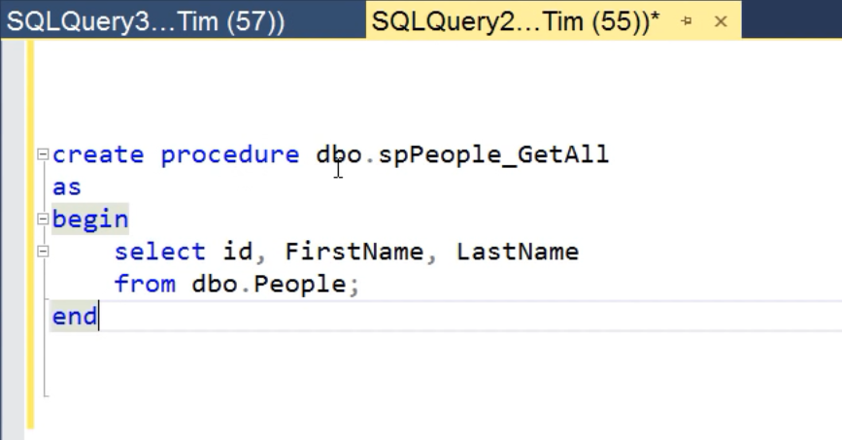
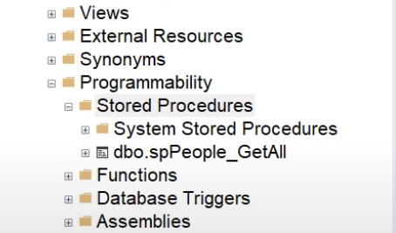
Creating a Stored Procedure
-A stored procedure is created using the example syntax shown
-The ‘sp_’ prefix is reserved for system level stored procedures
-In SSMS, stored procedures are then added to the Stored Procedures folder within the Object Explorer

Slide 4
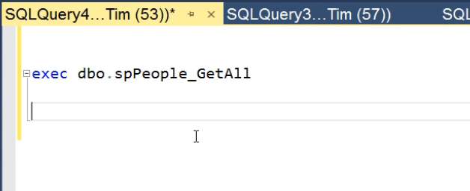
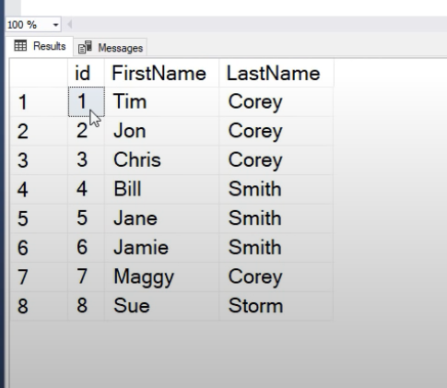
Calling a Stored Procedure
-Stored procedures are called using the exec keyword.
-Since stored procedures are precompiled, they may remove a level of overhead that a direct call can introduce.
-However, MS Sql Server has support for frequent direct call caching.

Slide 5
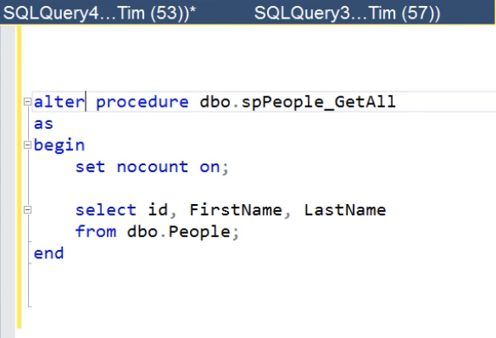
Modifying a Stored Procedure
-Changing a stored procedure can be done through the alter keyword.

Slide 6
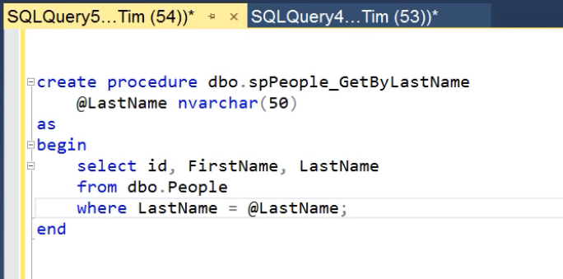
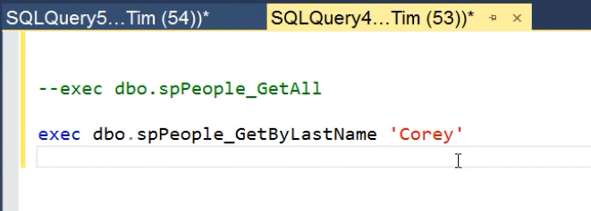
Variables and arguments in Stored Procedures
-Arguments in stored procedures are created using the ‘@’ prefix before the procedure query.
-Multiple arguments may be passed in using a ‘,’ following each argument.

Slide 7
Benefits of Stored Procedures
- Multiple actions may take place in one transaction.
- Rollbacks
- Precompiled performance
- Security (Roles and Users)
- Definition
- Lowers risk of SQL injection attacks
- Reduced network traffic

Slide 8
Drawbacks
- No source control (No git)
- Introduces business logic in database
- Not a whole lot of support in ORMs (Entity Framwork, ADO.NET)

Slide 9
References
-https://www.youtube.com/watch?v=Sggdhot-MoM
-https://www.w3schools.com/sql/sql_stored_procedures.asp

